Slide 1


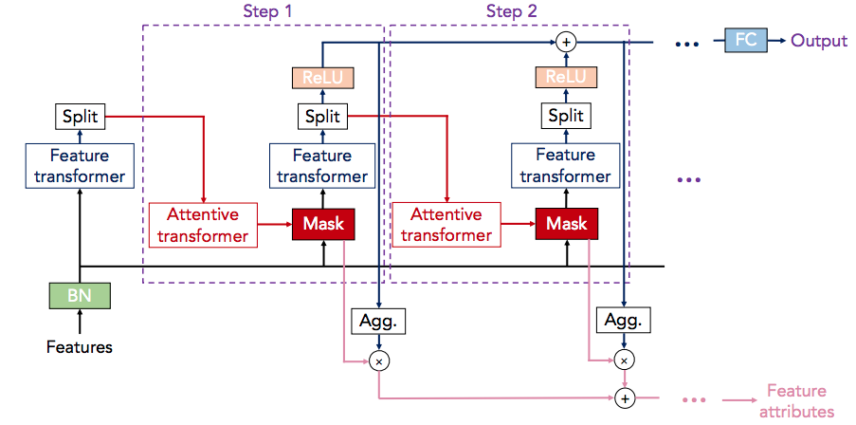
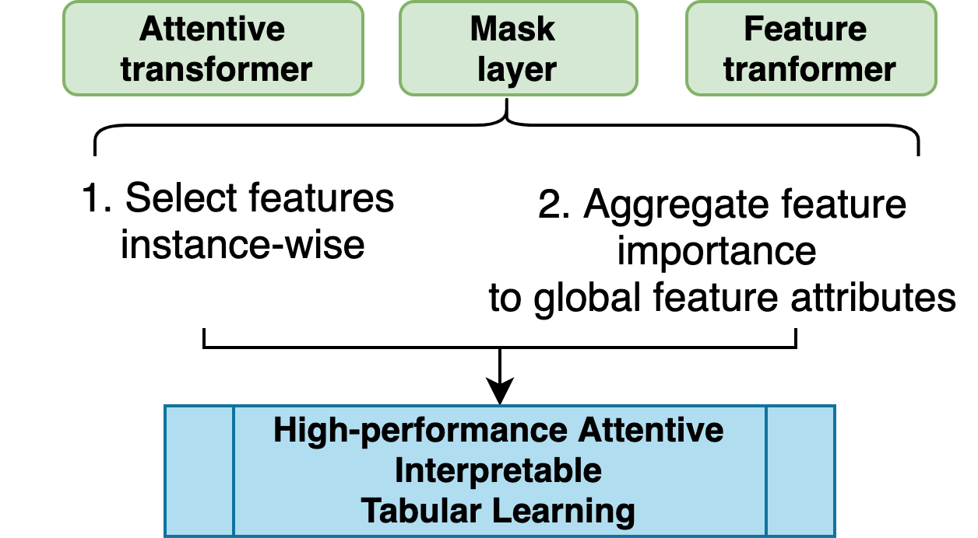

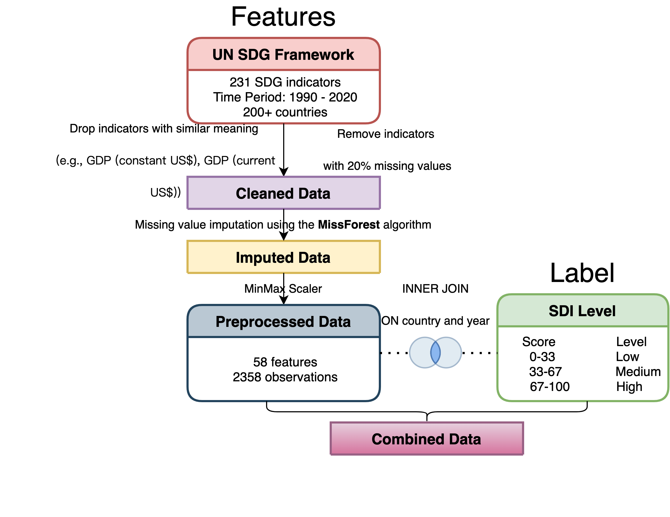

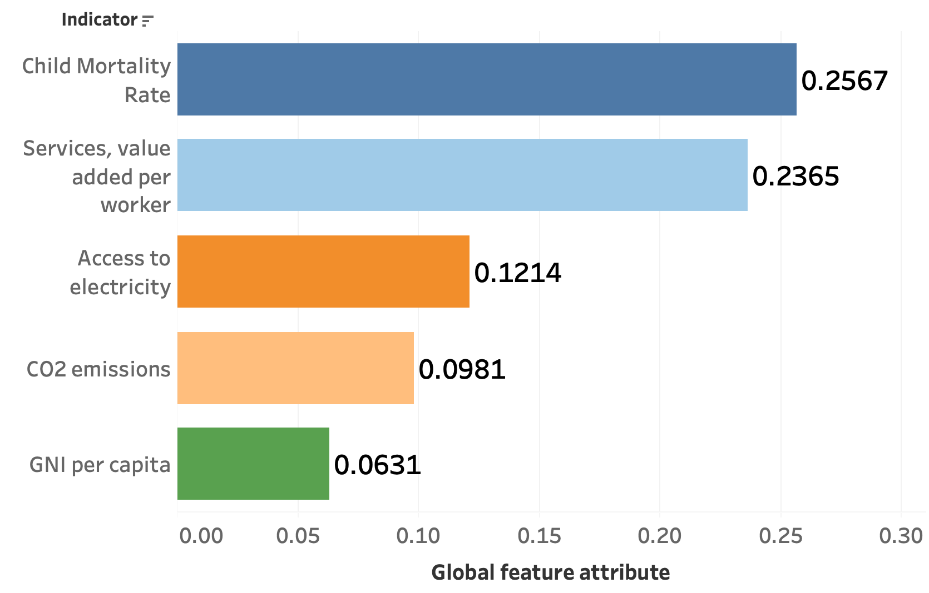
Making Sustainable Development Prediction to Prioritize Sustainable Development Goals (SDGs) Using TabNet
Zizheng Wang, Central South University Mentor: Professor Al Chen
Contact: wzz990506@gmail.com
1. Introduction
3. Methodology
5. Contributions
Since the UN proposed The 2030 Agenda for Sustainable Development and the 17 SDGs, how to accelerate the achievement of these goals has become a worldwide issue. This project intends to build a machine learning model to predict sustainable development given some indicators and prioritize the SDGs based on their importance for sustainable development.
Advantages of TabNet
Built an instance-wise TabNet model to classify sustainable development level based on existing framework.
Identified the most important indicators for sustainable development, and provided constructive advice on what SDGs to prioritize.
Fig.2. TabNet’s architecture
Table 2. Advice on prioritizing SDGs
4. Results
Indicator | Interpretation | Advice
Child mortality rate | 15000 children die on average every single day. | Reducing child mortality is a key target of the SDGs
Services, value added per worker | A measure of labor productivity | Balance productivity and sustainability
Access to electricity | Crucial for poverty alleviation, economic growth and improved living standards | Access to affordable, reliable and modern energy services must be assured for all
CO2 emissions | Primary driver of climate change and undoubtedly the most important in the environmental pillar | The whole world needs to unite to reduce it. China and USA must take a stand.
GNI per capita | Representation of the economy of a country and a measure of social fairness. | "Equal pay for work of equal value”
2. Data
TabNet significantly outperforms other popular machine learning models.
Room to improve the performance through hyperparameter tuning.
Table 1. Evaluation and comparison
Model | Balanced Accuracy | F1 Score | AUC | Log Loss
Tuned TabNet | 91.81% | 0.9317 | 98.61% | 0.1712
TabNet | 90.36% | 0.9314 | 98.41% | 0.1816
XGBoost | 88.86% | 0.9266 | 98.44% | 0.1966
Random Forest | 87.79% | 0.9112 | 98.16% | 0.2426
Logistic Regression | 74.53% | 0.8171 | 91.89% | 0.4350
AdaBoost | 72.91% | 0.7273 | 82.04% | 0.9073
Obtained the top 5 most important indicators according to their global feature attributes ranking (left figure).
References
UN General Assembly, Transforming our world: the 2030 Agenda for Sustainable Development, 21 October 2015, A/RES/70/1
Arik, Sercan Ö. and Tomas Pfister. “TabNet: Attentive Interpretable Tabular Learning.” AAAI (2021).
Fig.1. Data preprocessing pipeline to prepare the UN SDG Framework and Sustainable Development Index datasets.

